Slide 1
Title: AI Based Accident Detection and Alert System Using CCTV Images
Presented By: NAGARAJ.V

Slide 2
1. INTRODUCTION:
Road accidents are increasing day by day.
CCTV cameras are available in many places.
But cameras are not monitored all the time.
So accidents may not be identified quickly.
This project uses AI to detect accidents automatically.
If accident is detected, alert message is sent to:
Police Station
Hospital
Ambulance
This helps in fast emergency response.

Slide 3
2.ABSTRACT:
This project detects road accidents using CCTV camera images.
The camera captures live images continuously.
AI model checks whether the image is accident or non-accident.
If accident is found, the system gets the location.
Then it sends an alert message to nearby:
Police station
Hospital
Ambulance
This reduces delay and helps save lives.

Slide 4
3. MATERIALS REQUIRED:
Hardware:
CCTV Camera / Webcam
Computer / Laptop
Internet Connection
GPS Module (optional)
GSM Module (optional)
Software:
Python
OpenCV
TensorFlow / Keras
VS Code / Jupyter Notebook
Dataset:
Accident Images
Non-Accident Images

Slide 5
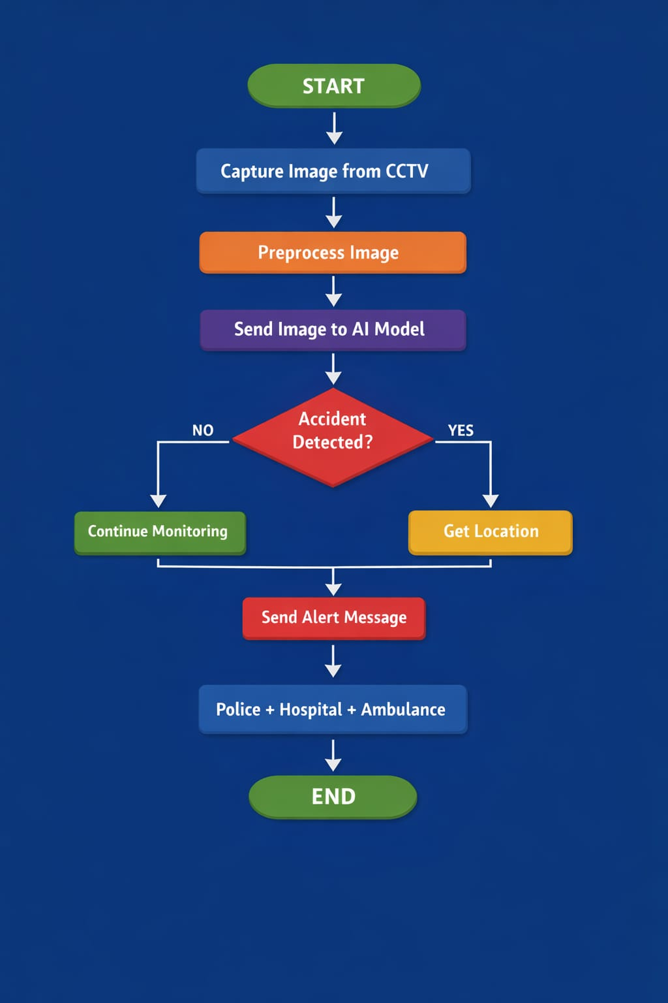
4. FLOW CHART:

Slide 6
7. COMPARISON:
Existing System
Manual CCTV monitoring
Delay in accident detection
Slow emergency response
Proposed System
AI based automatic detection
Fast accident identification
Instant alert with location

Slide 7
6. APPLICATIONS:
Smart City Traffic Monitoring
Highway Accident Detection
Police Control Rooms
Hospital Emergency Systems
Ambulance Alert Systems

Slide 8
5. ADVANTAGES:
Detects accident automatically
No need for full-time human monitoring
Sends alert quickly
Gives location details
Helps police and hospital respond fast
Saves time and lives

Slide 9
8. CONCLUSION:
This project uses AI + CCTV to detect accidents.
It identifies accident images automatically.
After detection, it sends alert message with location.
It helps police, hospital, and ambulance reach faster.
This project improves road safety and saves lives.

